Slide 1

Social Engineering Project: Understanding Digital Footprints
By: Rosemarie Kpaka

Slide 2
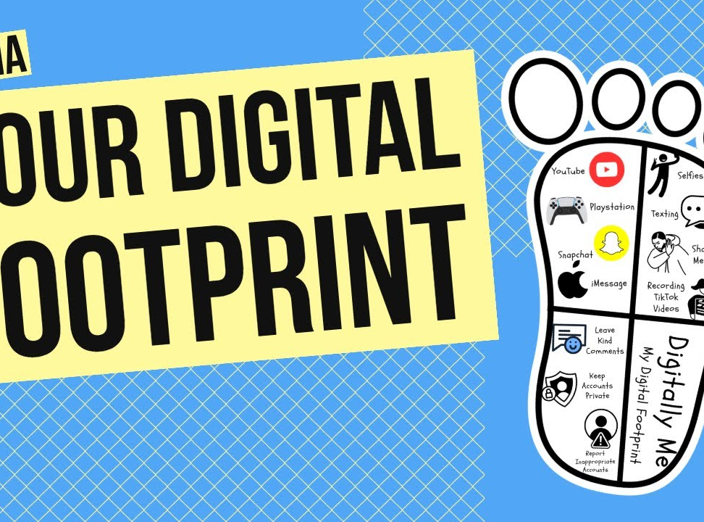
What is Digital Footprint?
A digital footprint refers to the traces of personal data left online through various activities, including social media interactions, online transactions, website visits, and employment profiles.
Every action taken on the internet contributes to a person’s digital footprint, making it crucial to understand its implications.

Slide 3

Objective of the Project:
The main objective of this project is to analyze a peer’s digital footprint to assess the type of personal information available publicly, determine potential security risks, and recommend protective measures.
This exercise aims to increase awareness of online privacy, demonstrate the vulnerabilities associated with personal data exposure, and encourage best practices in digital security.

Slide 4
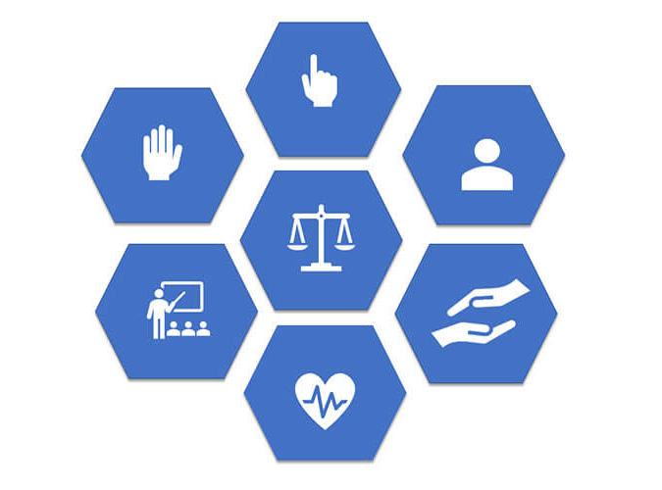
Ethical Considerations
Before conducting any research, consent was obtained from all participants to ensure ethical standards were met.
The research focused strictly on publicly available information, and any sensitive details were anonymized to protect privacy.
This study was conducted for educational purposes only, and no unauthorized access methods were used.

Slide 5
Ethical Research Guidelines:
Only publicly accessible information was collected.
No attempts were made to bypass privacy settings or access restricted content.
The information collected was used strictly for analysis and awareness purposes.
Respect for personal data and confidentiality was maintained throughout the project.

Slide 6
Research Methodology
Google searches: Using advanced search operators to filter results and locate specific information.
Social media analysis: Reviewing publicly available posts, connections, and interactions on platforms such as LinkedIn, Instagram, and Twitter.
Public records and online databases: Checking publicly accessible employment history and academic records.
The research was conducted using various open-source intelligence (OSINT) techniques.
The primary methods of data collection included:

Slide 7

Collected Information
Basic Details:
Name: Ansley Jean
Birthdate: April 2, 2001
Address: Hagerstown, MD (Generalized for privacy)
Contact Information:
Email: (Anonymized for privacy)
Phone number: (Anonymized for privacy)
Employment and Education:
Current Employer: BJ’s Wholesale Club (Front End Associate)
Previous Employer: TJ Maxx (Cashier/Sales Associate)
Education: Studied at Bowie State University (2019 - 2023)

Slide 8

Social Media Presence
Platforms Found:
LinkedIn: Active profile detailing employment history and career interests.
Instagram & Twitter: Two public accounts under different usernames.
Online Activities:
Posts related to job experiences and interests: Shared posts about employment at Adobe and BJ’s Wholesale Club.
Participation in discussions and forums: Engaged in conversations related to computer technology and software engineering.
Professional Networking: Openly seeking job opportunities and internships in software engineering.

Slide 9
Risk Analysis & Vulnerabilities
Publicly visible personal information: Birthdate, location, employment history, and contact details make identity theft and phishing attacks easier.
Potential for phishing attacks: Since the individual is actively seeking employment, scammers could impersonate recruiters with fraudulent job offers.
Social media exposure: Public posts, location tags, and connections provide cybercriminals with patterns of behavior and social interactions that can be exploited.
Risk of impersonation and identity theft: With personal details easily accessible, an attacker could create fake accounts or use the information for fraudulent activities.

Slide 10
Recommendations for Security Improvement
To minimize security risks and protect personal information, the following measures are recommended:
Restrict Personal Information: Avoid posting identifiable details such as birthdate, address, and full employment history on public platforms.
Improve Privacy Settings: Adjust social media privacy controls to limit who can view personal information and posts.
Limit Oversharing Online: Be cautious when posting about daily activities, travel plans, and personal achievements.
Be Cautious of Online Interactions: Verify job offers and messages from unknown contacts before engaging.
Enable Two-Factor Authentication (2FA): Add an extra layer of security to prevent unauthorized access.

Slide 11
Key Takeaways
1
2
3
4
Regularly review and update privacy settings.
Use strong, unique passwords for different accounts.
Be mindful of what is shared online, especially on professional and personal platforms.
Monitor online presence to detect potential impersonation attempts.
Information posted online can remain accessible indefinitely.
Even seemingly harmless data can be exploited for social engineering attacks.
Cybercriminals rely on publicly available information to craft convincing scams.

Slide 12
Conclusion & Reflection
Lessons Learned:
The project highlighted how easy it is to gather personal information from publicly available sources.
Social engineering threats rely heavily on information that people willingly share online.
Taking proactive steps to secure digital footprints can significantly reduce security risks.
Final Thoughts:
Awareness is key to cybersecurity: Individuals must be mindful of their online activities and digital exposure.
Digital footprints should be managed regularly: Reviewing and updating online profiles can help minimize risks.
Adopting cybersecurity best practices is essential: Protecting personal data is crucial in preventing identity theft and fraud.

Slide 13

Thank You!
By: Rosemarie Kpaka

